Slide 1
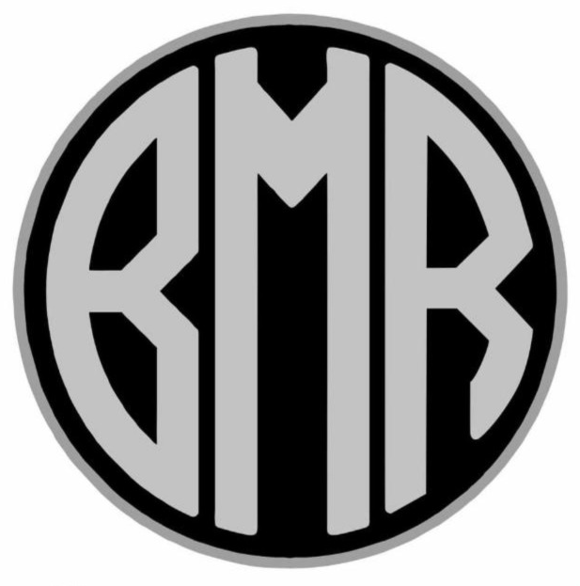
Extend Happiness
Forever Togetherness!
BMR EV ASSURANCE & WARRANTY POLICY.
BMR XL 200
BMR XL 200 LITE
BMR BLISS

Slide 2
Greetings from BMR EV & Thank you for choosing a BMR EV Product !
Congratulations on your new BMR EV Product. We trust it meets your needs and will provide you with many years of trouble free riding experience.
A BMR EV is the result of years of research, R&D and expert minds following “I am BMR Craftsmanship” coming in to bring you a state of the art, futuristic and reliable EV product that is bound to redefine vehicle ownership in the long term. “I am BMR Craftsmanship” or “ BMR Craftsmen” is an individual who has developed his or her skills with years / decades of experience to become the truly best in his / her trade.
We understand most of our customers are transitioning from conventional fossil fuel running based vehicles as the world transitions into EV’s and ownership of an EV might seem like a daunting task, However as part of the BMR EV family we are committed to ensuring you are eased into this transition in a safe and guided manner.
We urge you to take multiple free of cost demos from your point of purchase for BMR EV or the nearest BMR EV dealership / distributorship to assist us in ensuring a smooth ownership for you.

Slide 3
Please note “Non adherence” of the aforementioned service schedule will result in the warranty being void. Adherence will result in the longevity of the product, lesser warranty claims and reduction of unwanted maintenance / breakdowns. Furthermore frequent service will result in longer life of the vehicle with lesser breakdowns and thereby result in better ownership satisfaction.
We have kept the service schedule conservative yet industry leading so as to concentrate more on preventive & predictive maintenance of parts (including wear and tear) rather than post breakdown maintenance.
More details are contained in the user manual so as to make you aware of the importance of this schedule for the safe, long term, reliable and affordable usage of a BMR EV product.
Wishing you a million+ worry free miles ahead !
Team,
BMR EV.

Slide 4
IMPORTANT
It is very important that you understand the warranty program, so please read each page of this booklet very carefully.
The warranty starts at the date of sale (as defined in your invoice), please read the terms and conditions thoroughly for details.
It is the responsibility of the customer to produce all necessary documents / records to prove that the two wheeler has been serviced at prescribed interval and maintained through BMR EV authorised dealership / Service center only.
Please ensure availing of all mandatory free / paid services on time to avoid invalidity.

Slide 5
DEFINITIONS
For your guidance
Warranty is designed to assist towards the cost of repairs / replacements of parts covered as mentioned in the booklet. The dealer will only accept the responsibility for repairs / replacement as per the terms and conditions mentioned in the warranty booklet(If needed upon intervention of BMR EV)
Period of cover
The term of the warranty period shall be for 24 months or 50,000 kms (whichever comes first).
Warranty obligation
If any of defect or defects should be found in your two wheeler within the terms stipulated, selling/dealer will be obligated to repair or replace at his sole discretion (under guidance of BMR EV), any part shown to be defected will be replaced or repaired with a new part or the equivalent at no cost to the owner for parts and labour, when the dealer acknowledges that such a defect is attributable to the breakdown as defined per the service guidelines.

Slide 6
PARTS COVERED
Warranty covers the parts listed over the following page for breakdown and the associated labour up to the limit specified on your warranty form. All claims must be made in accordance with the claims procedure described or referred in this booklet and the terms and conditions. Warranty does not cover parts that fail as a result of normal wear and tear.
GROUP | CONTINGENT
Controller | MOSFET etc not pertinent to burn outs due to overload, bruning of terminals (+ AND OR -)
Converter | Not pertinent to water egress due to improper use
Harness | Not pertinent due to modification, cutting (& /) or splicing of wires
Motor | Not pertinent or Hall sensor failure due to overload or wrong voltage battery or physical damage of any kind
Speedometer | Not pertinent to water ingress or improper wash process / tapping
Front Brake | Not pertinent to wear & tear of disc pad / disc / caliper
Rear Brake | Not pertinent to wear & tear of disc pad / disc / caliper

Slide 7
Bearings | Not pertinent to improper lubing or wear and tear
Springs | Not pertinent to improper lubing or wear and tear
Instrument Cluster / Switch Gear | Not pertinent to water ingress due to accidental damage or improper use
Lighting System (Bulbs / LED) | Not pertinent to improper usage or water damage
Alloy Wheels | Not pertinent to rust or bend damage due to road conditions / improper usage
Cables | Not pertinent to cutting / splicing / parallel connections / series connections / tapping
Fabrics / Foam | Not pertinent to load conditions or whether based on wear and tear
Plastic & Body Panels | Not pertinent to damage due to accidents / excessive load / load bearing

Slide 8
WARRANTY SHALL NOT APPLY TO
Any BMR EV Two-Wheeler manufactured by BMR EV on which all free & paid services as given in the owner’s manual have not been carried out.
Normal maintenance service required including limitation balancing & fluid changes, headlight alignment, fastener re-tightening, wheel balancing, wheel alignment, brake adjustments, BMS Balancing & clearance or such other adjustments.
Normal wear & tear components that is, Bulbs / LEDs / Fasteners / Shims / Washers, Oil Seal, Rubbers / Plastic or Glass Components, Gaskets, Rubber tubes & hoses, All burnt & tampered parts, Tire, Tube, Brake Shoe / Pad, Brake Drum, Seat, Locks, Luggage Box, Winker/flasher Bulbs, Head light & Tail light Assy, Battery, Tools, Labels & Emblems, Inner Box
All those parts, which are not mentioned in the parts covered list.

Slide 9
4. If recommended Service / Lubricants are not used or if they are not replaced at the recommended interval.
5. Parts of the vehicle that have been subjected to Misuse, Accident, Negligence.
6. Treatment or which have been used in conjunction with parts & equipment not manufactured or recommended for use by BMR EV if in the sole judgement of BMR EV, Such use prematurely affects the performance and reliability of the vehicle.
7. Parts of the vehicle that have been altered or modified or replaced in unauthorized manner, and which in the sole judgement of BMR EV affects its performance & reliability.
8. Premature wear of Engine parts such as motor , HALL sensor, controller / mosfets, Wear / Tear parts and bearings due to fluctuations or changes in load prescribed / charing infra.
9. The vehicle that has not been serviced by BMR EV Dealer / Service Centre as per the service schedule or which have not been operated or maintained in accordance with instructions mentioned in the owner's manual.

Slide 10
10. The vehicles used for a competition or race and / or for attempting to set up any kind of record.
11. Any natural wear & tear including without limitation ageing etc.
12. Insignificant defects, which do not affect the functions of the two-wheeler including without limitations, sound vibration and fluid seepage.
13. Any two-wheeler on which parts or accessories not approved by BMR EV has been used.
14. Any repair or replacement required as a result of accident or collision damage.
15. Warranty shall cease to operate in case of an accident on parts affected by the accident.

Slide 11
SERVICE REQUIREMENT
In order to maintain the validity of Warranty, the Two-Wheeler must be serviced by BMR EV Dealer / Service Center in accordance with the manufacturer’s recommendations.
Please Note:
The interval from the purchase date to the first service and the intervals between services there after, must not be exceed the stipulated mileage or time by more than 100 Kms Or 15 days whichever is earlier. This time allowance is to assist the Two-Wheeler owner to ensure that the services are completed at the correct intervals. If any circumstances prevent the service being carried out at the correct time, Dealer must be informed immediately by recorded delivery of said vehicle.
Failure to maintain and prove that the above service Schedule has been compiled which will invalidate warranty.
Gap between two services should not exceed more than 15 days or 100 kms (whichever is earlier)
Note: The only proof that servicing has been carried out will be, the fully detailed service invoice(s) indicating service date(s) and mileage(s). For your own protection you should retain these documents for inspection in the event of a claim.
The customer shall effect at his cost, all modifications and repairs necessary to avoid a claim, if a claim is likely to occur in the absence of the above.

Slide 12
CUSTOMER RESPONSIBILITY
Take the Two-Wheeler to nearest BMR EV Dealer / Service Centre and give the workshop manager warranty booklet and confirmation that the service is up-to-date.
The authority to dismantle any component(s) must be given by the customer to the repairer.
The Vehicle should have been maintained as per the manufacturer recommended Service schedule.

Slide 13
TERMS AND CONDITIONS
Warranty does not apply to Two-Wheelers used for hire / taxi/ rally / campaign or used for any kind of timed competition, Race or event.
Warranty plan has no surrender value, no refund of cost is available, and it cannot be cancelled.
Two Wheelers owned, temporarily or otherwise by a business formed for the purpose of selling or servicing, renting two-wheelers are excluded from this program.
Services must be completed at the correct timelines and mileages. Customer must retain all the service invoices and relevant received. Failure to service the two-wheeler in accordance with the manufacturer's recommended service schedule will render the warranty invalid.
The mileage quoted in no way guarantee the true distance covered by the two-wheeler and is indicated only as a guide to when servicing is due. Failure to maintain the odometer, mileage recorder in working order or disconnecting it or tampering with it will invalidate warranty.

Slide 14
No liability will be accepted for damage caused by neglect, corrosion, intrusion of foriegn or deleterious matter, lack of servicing, over heating, flooding, freezing or abuse by the continued use of the two-wheeler after a fault has become evident or for consequential loss on the failure of parts not covered under warranty.
No liability will be accepted for any failure due to wear & tear, components
incorrectly fitted or faulty or defective at the time of sale or faulty manufacturer/ design and alteration/ modification form the manufacturers specification.
All Disputes/ difference regarding claim settlement, arising for whatsoever reason shall be subject to jurisdiction of Chittoor, Andhra Pradesh Courts only.

Slide 15
SERVICE SCHEDULE:
*Post 5th service - All services are dependent on wear and tear determination
S NO | SERVICE NO | KMS / MONTH | CONTROLLER | CONVERTER | SB 50 PLUG | BATTERY | WASHING | BRAKE (F) | BRAKE (R) | TYRE (F) | TYRE (R)
1 | FIRST SERV | 500 KM / 1 MONTHS | CHECK | CHECK | CHECK | CHECK | CHECK | CHECK | CHECK | CHECK | CHECK
2 | SECOND SERV | 2000 KM / 3 MONTHS | CHECK | CHECK | CHECK | CHECK | CHECK | CHECK | CHECK | CHECK | CHECK
3 | THIRD SERV | 5000 KM / 6 MONTHS | CHECK | CHECK | CHECK | CHECK | CHECK | CHECK | CHECK | CHECK | CHECK
4 | FOURTH SERV | 8000 KM / 12 MONTHS | CHECK | REPLACE | CHECK* | CHECK* | CHECK* | CHECK* | CHECK* | CHECK* | CHECK*
5 | FIFTH SERV | EVERY 4000 KM / 4 MONTHS | CHECK | CHECK* | CHECK* | CHECK* | CHECK* | CHECK* | CHECK* | CHECK* | CHECK*

Slide 16
* NOTE:
1) CONTROLLER TO BE REPLACED AFTER 24 MONTHS OF USE.
2) CONVERTER TO BE CHANGED ONCE A YEAR.
3) TYRE VALVES TO BE REPLACED EVERY YEAR.
4) TYRES TO BE CHANGED EVERY 3 YEARS OR 35,000 KMS WHICHEVER COMES FIRST.
5) BATTERIES TO BE CHECKED AND BALANCE @ 20,000 KMS.
6) CHARGER TO BE REPLACED EVERY 18 MONTHS / 30,000 KMS WHICHEVER COMES FIRST.
7) BATTERY TO BE REPLACED @ 80,000 KMS ON INSPECTION / WARRANTED CYCLE COUNT.
8) HORN TO BE REPLACED EVERY 24 MONTHS / 25000 KMS WHICHEVER COMES FIRST.

Slide 17
GOOD EV PRACTICES:
DO’S:
- Let the battery rest for 30-45 mins after running in vehicle before placing it on charge to allow cool off time
- Do not pressure wash under the seat area
- Check tyre air pressure every week, Front Tyre - 32 Psi , Rear Tyre - 34 Psi (+ 2 psi rear for heavy load)
- Get the vehicle serviced as per the service schedule
- Remove the battery charger and trip the MCB to off position before washing the vehicle.

Slide 18
DON'TS:
- Do not let the battery or charger get wet.
- Do not over inflate the tires, use digital scales in petrol pumps only.
- Don't use any kind of oil or lube on the vehicle.
- Don't install any lights or any other electrical accessory on the vehicle other than BMR EV official accessories.
- Do not ride the vehicle in severely waterlogged areas.
- Do not charge the batteries / vehicle without earthing / voltage protection in the grid / Plug point.
- Do not charge the vehicle immediately after riding, please allow it to rest for 30-45 mins.

Slide 19
CHARGER MANUAL
IPOWER ASSURANCE & WARRANTY POLICY.
NMC / LFP CHARGER - 6A & 10A

Slide 20
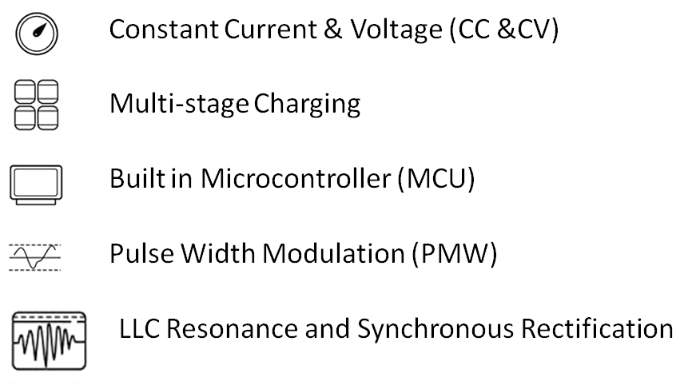
PRODUCT FEATURES
Note : These techniques will ensure
System integrity and precisely control
The charging voltage and current. The
Battery will be fully charged but not overcharged.

Slide 21

WHAT’S IN THE BOX

Slide 22
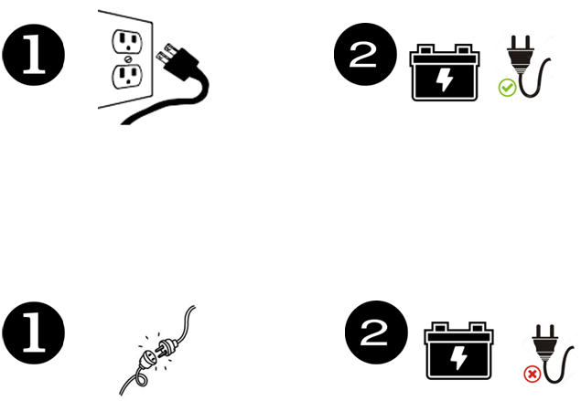
OPERATION INSTRUCTION
Please make sure the charger is firmly connected to the battery.
Note: Plug the charger into the battery after plugging into the standard AC outlet
The charger will be turned off automatically after the battery is fully charged.
Unplug charger from AC outlet when the charger is not in use.
Note: Unplug the charger from AC outlet plugging the battery.
Some chargers are not designed to carry with the vehicle.
Please make sure the voltage from AC outlet matches that required by the charger .
Please read the product manual carefully before using the charger.
We will not be responsible for any improper operations.

Slide 23
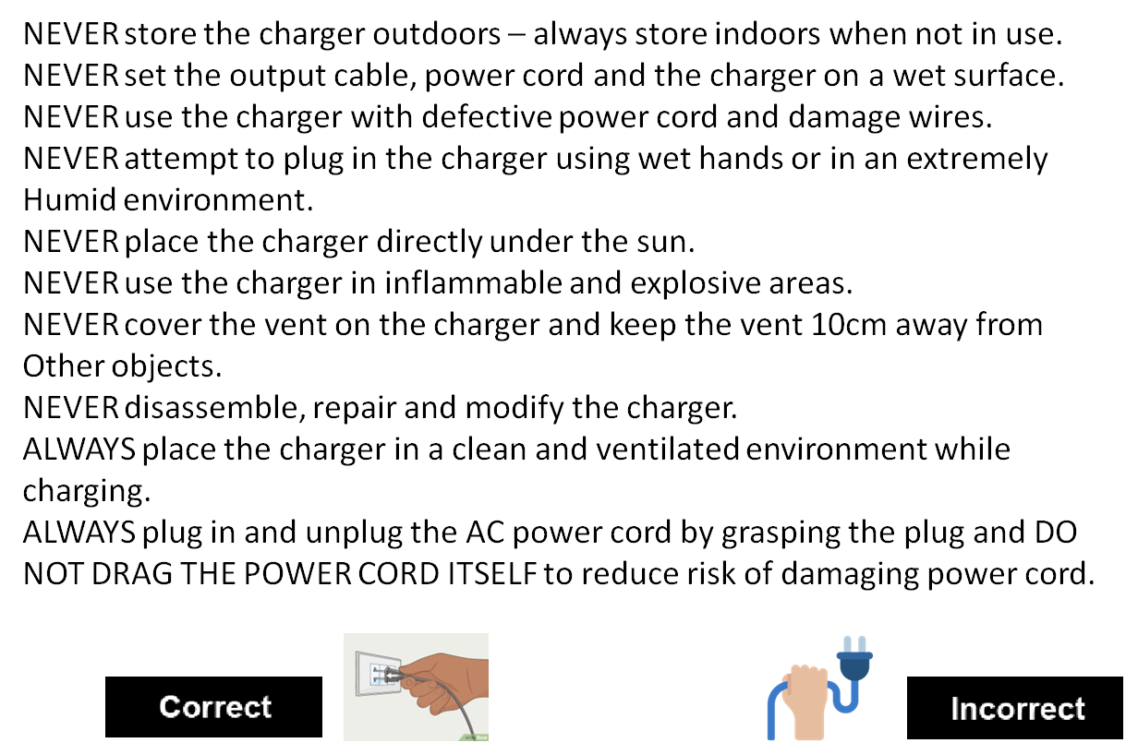
SAFETY INFORMATION

Slide 24
LIMITED WARRANTY
We guarantee that every charger has been tested before shipping. Please
Contact the customer support immediately, if there are any damages to the
Charger. Following the shipping date, we offer a 12-month warranty. And this
Warranty applies to the charger only. The replacement or repair of other
Products shall be at the expense of the owner.
The warranty is void if:
• Warranty period has passed
• No receipt or invoice
• The damage is caused by improper operation
• The owner does not follow this instruction.
• The damages caused by force majeure.

Slide 25
WARRANTY CARD:
Customer Information: | Vehicle Information: | Battery Information:
Name:_____________________ | Date of Invoicing: _________________________________ | Battery Type: ____________________________
Local Address:________________ | Dealer Name: _____________________________________ | Battery No.1:_____________________________
__________________________ | Chassis No: ______________________________________ | Battery No.2:_____________________________
__________________________ | Motor No: ________________________________________ | Charger No.1: ____________________________
__________________________ | Manufacturing Year: _______________________________ | Charger No.2:____________________________
CX No: ___________________ | Odometer Reading on Delivery: ______________________ | Battery Warranty:__________________________
Ph. (M) ____________________ | Period of Cover : _________________________________ | Charger Warranty:_________________________
(M) _______________________ | Extended Warranty Purchase Code:___________________ | Location:___________________________
Email:_____________________ | Dealer Code: _____________________________________
I have read and agree to the terms & conditions of Warranty ___________________________________________________ Customer Sign & Date |  | The above information is true and correct to the best of my knowledge __________________________________ Dealer's Name, Date & Stamp

Slide 26




CONTACT - WE CARE
Dealership Enquiry
Office Address
BMR EV Industries Pvt Ltd
No.1, BMR Gardens, Ganganapalli
Chittoor, AP, India - 517001
Dealership@BMRev.in
+91 903 011 0915
Existing Dealership
Plant Address
BMR EV Industries Pvt Ltd
Mordanapalli (Vill), Yadamari (Mandal)
Chittoor - Bangalore Hwy ,
Chittoor, AP, India - 517128
Partner@BMRev.in
+91 858 701 4234
Sales
Escalation Matrix
Sales@BMRev.in
www.BMRev.in
+91 868 829 8160
Escalation@BMRev.in

